Slide 1
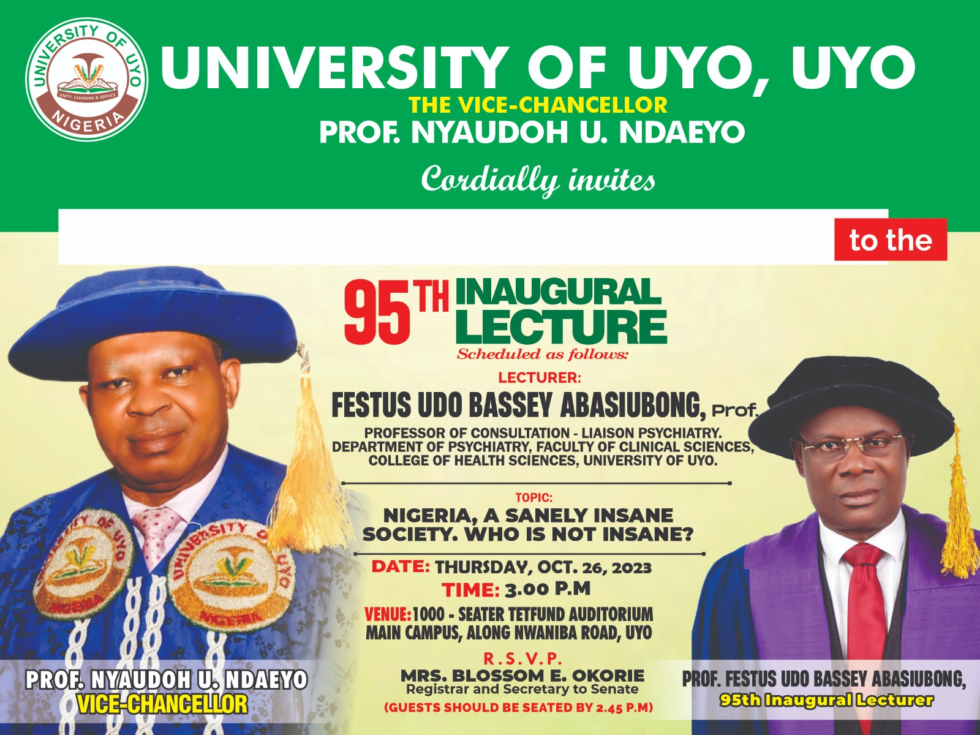
Welcomes You

Slide 2
NATIONAL ANTHEM

Slide 3
Welcomes You

Slide 4
UNIUYO ANTHEM
Let us all rise as one and light up
Wisdom’s pa-th, the citadel
Our great forebears raised
From nur-sery to its apogee
Now stands like a giant
In the African Sun
Arise, Arise, G-r-e-a-t UNIUYO
We shall arise and
Shine and take our place
In the fir-ma-ment
Of cultured men; And women Blest
With wisdom’s depth of vision
And leave behind
Traditions for generations to come
Arise, Arise, G r e a t Uniuyo
Arise, Arise, Arise, and shine forth...
G-r-e-a-t UNIUYO

Slide 5
INAUGURAL LECTURE
OF THE UNIVERSITY OF UYO
Opening
Prayers

Slide 6
INAUGURAL LECTURE
OF THE UNIVERSITY OF UYO
THURSDAY, OCTOBER 26, 2023

Slide 7
INAUGURAL LECTURE
OF THE UNIVERSITY OF UYO
By
PROFESSOR FESTUS UDO BASSEY ABASIUBONG
Professor of Consultation-Liaison Psychiatry
College of Health Sciences,
University of Uyo, Uyo.
Topic:
NIGERIA, A SANELY INSANE SOCIETY. WHO IS NOT INSANE?
THURSDAY, OCTOBER 26, 2023.

Slide 8
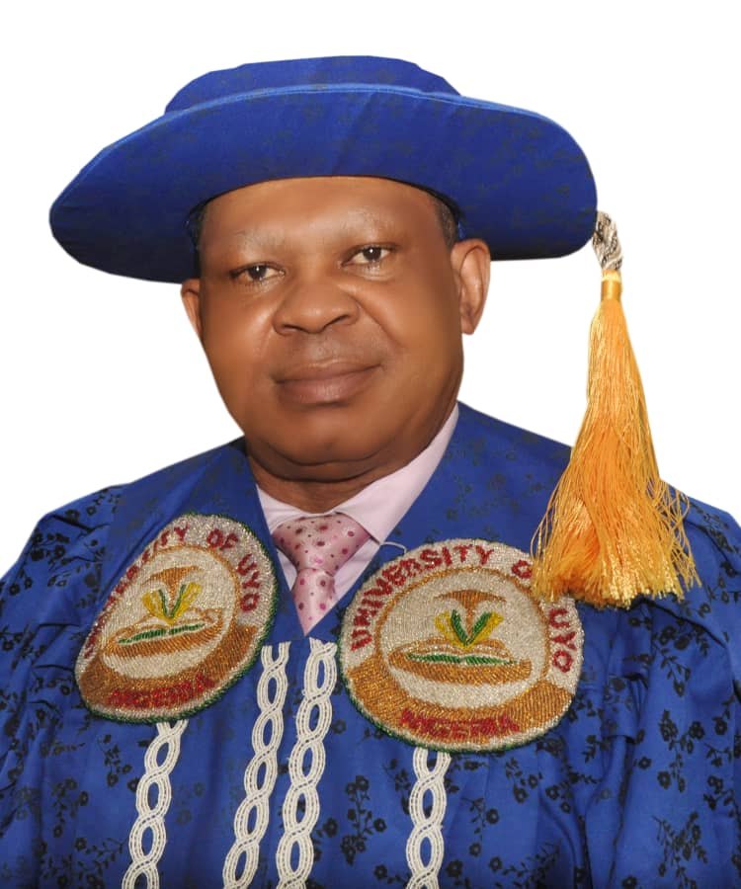
Chairperson’s Opening Remarks…
INAUGURAL LECTURE
OF THE UNIVERSITY OF UYO
Professor Nyaudoh Ndaeyo
Vice-Chancellor, University of Uyo, Uyo

Slide 9
INAUGURAL LECTURE
OF THE UNIVERSITY OF UYO
By
PROFESSOR FESTUS UDO BASSEY ABASIUBONG
Professor of Consultation-Liaison Psychiatry
College of Health Sciences,
University of Uyo, Uyo.
Topic:
NIGERIA, A SANELY INSANE SOCIETY. WHO IS NOT INSANE?
THURSDAY, OCTOBER 26, 2023.

Slide 10
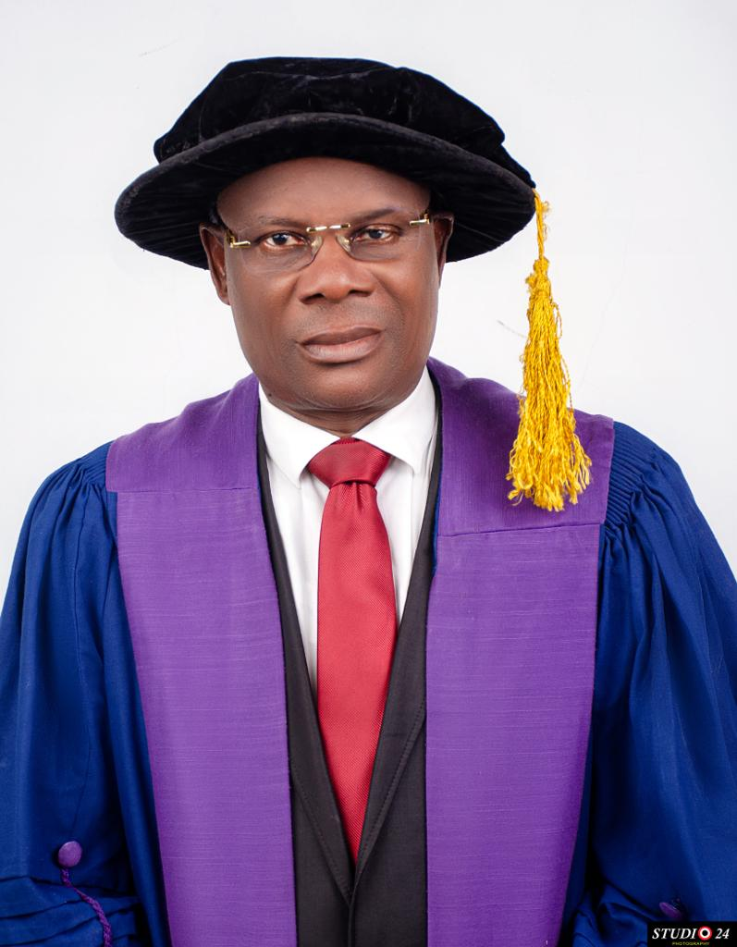
Citation of Professor Festus Udo Bassey Abasiubong
by
PROF. INYANG ATING
95TH Inaugural Lecturer Presenter

Slide 11
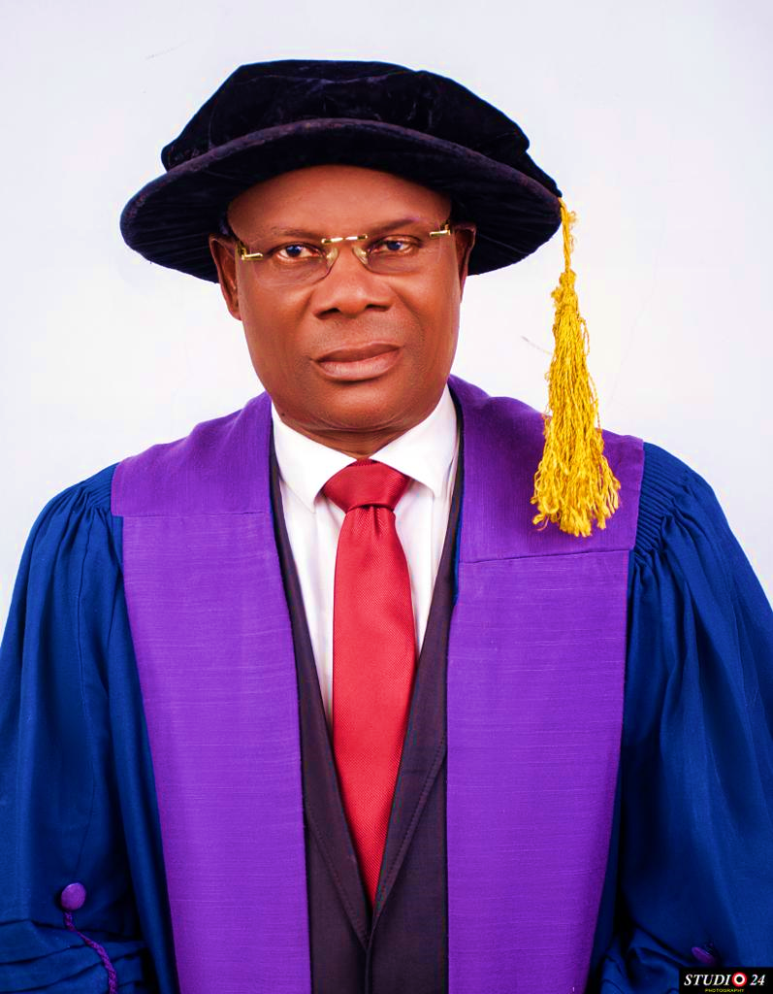
PROFESSOR FESTUS UDO BASSEY ABASIUBONG
Professor of Consultation-Liaison Psychiatry
College of Health Sciences, University of Uyo, Uyo.

Slide 12
NIGERIA, A SANELY INSANE SOCIETY. WHO IS NOT INSANE?
INAUGURAL LECTURE
OF THE UNIVERSITY OF UYO
PROFESSOR FESTUS UDO BASSEY
ABASIUBONG

Slide 13
Protocol

Slide 16
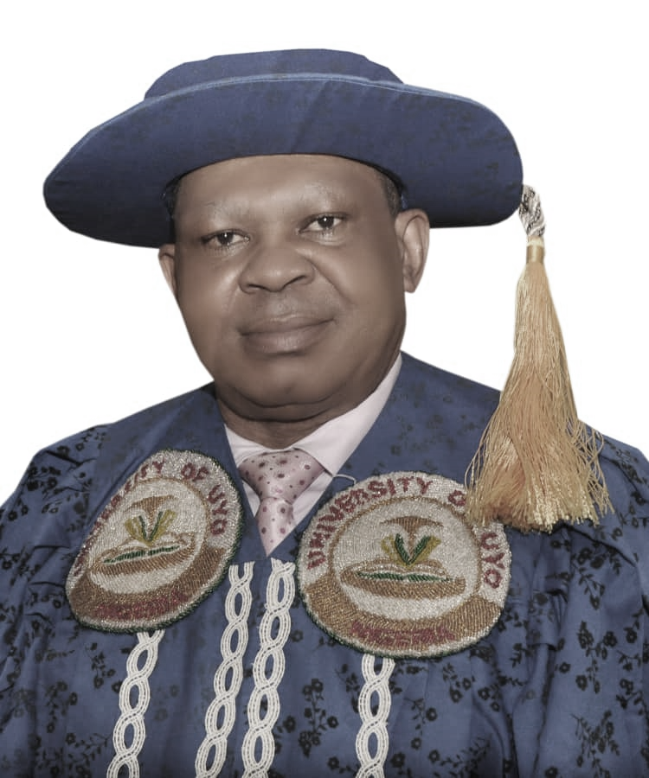
Professor Nyaudoh Ndaeyo
Vice-Chancellor, University of Uyo, Uyo

Slide 17
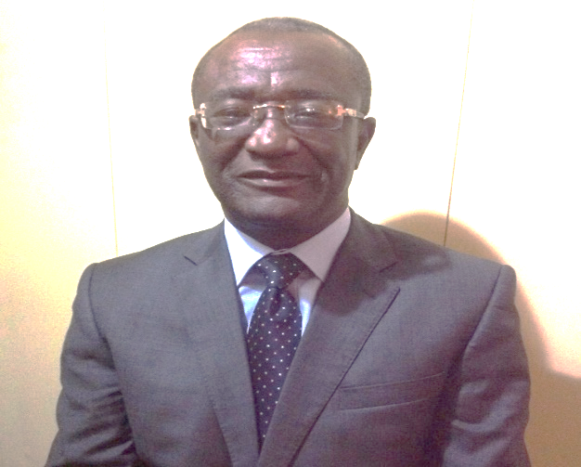
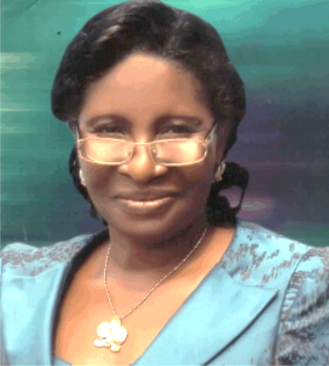
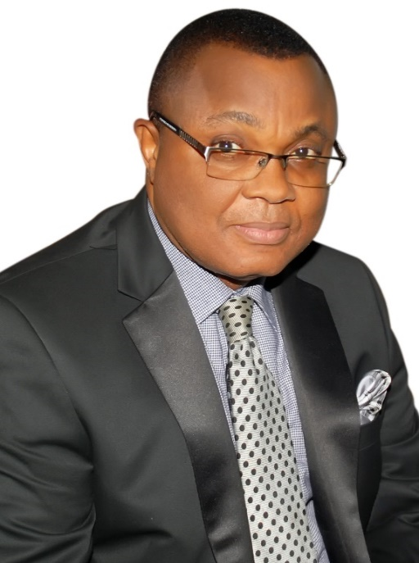
Prof. Akaneren Essien
Prof. Comfort Ekpo
Prof. Enefiok Essien

Slide 18
Prof. Akaneren Essien

Slide 19
Prof. Comfort Ekpo

Slide 20
Prof. Enefiok Essien SAN

Slide 21
Late father, Mr. Udo Bassey Abasiubong & Mother
Mrs. Nko Bassey Abasiubong

Slide 22
My Mentors…

Slide 23
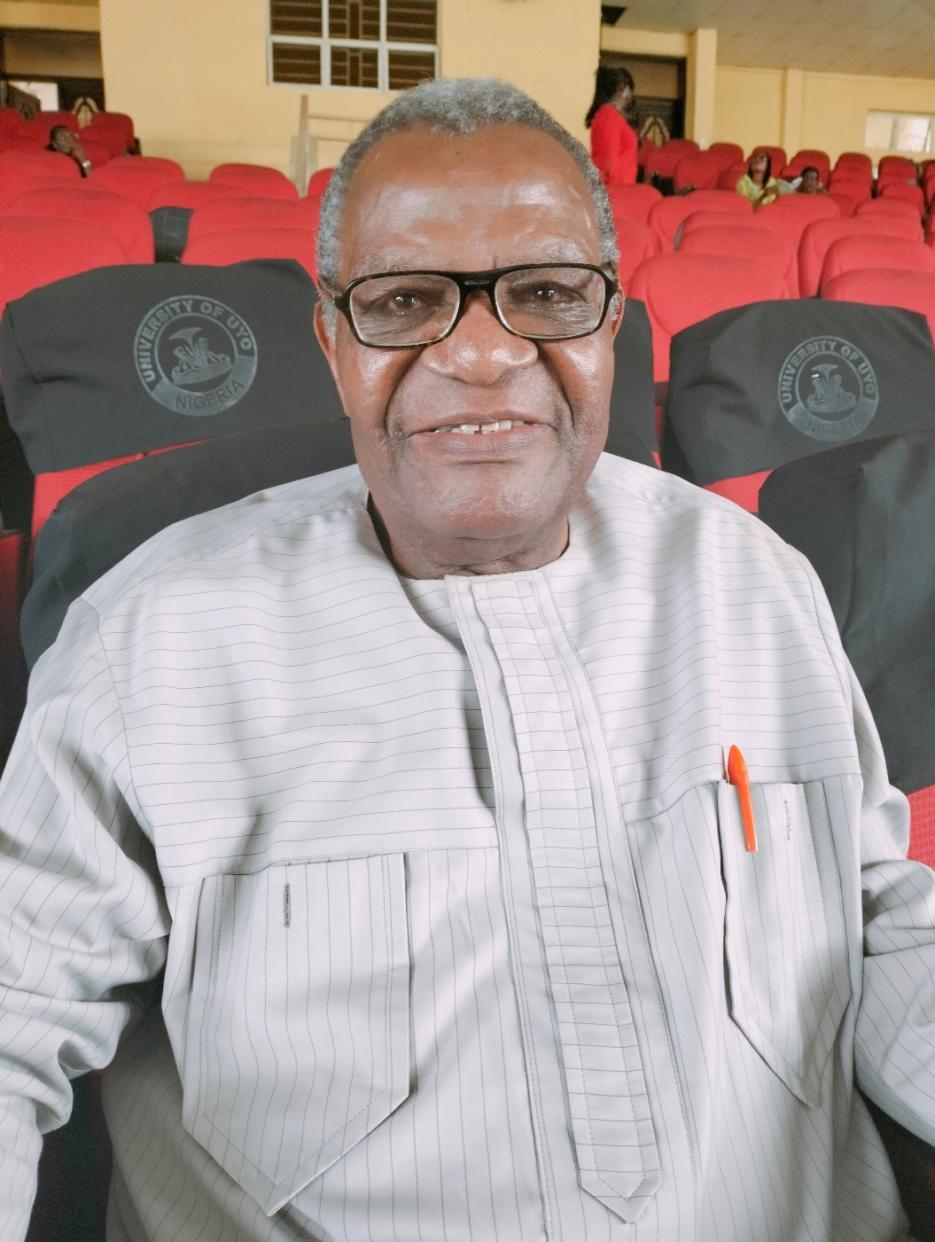
Professor Joseph John Andy

Slide 24
Professor Emmanuel Eyo Ekanem
[
Professor Paul Dickson Ekwere

Slide 25
Professor Enobong Emmanuel Ikpeme
Professor Dianabasi Udoette Eduwem
Dr. Henry Effiong Jombo
Dr. Awajimoror Roland Isotu
Dr. Ogundipe Sunday Seyi
Dr. David Nkereuwem Wilson
Dr. Enobong Kufre Nkanga
Dr. Evelyn Osemhen Ezeaku
Mrs. Uduak Umoren
Mrs. Rosemary Ekanem

Slide 26
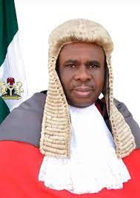
JUSTICE GODWIN ABRAHAM

Slide 27
Barrister Francis Ekanem

Slide 28
Professor Sunday Bassey Udoh
Professor Dominic Ignatius Ukpong
Dr. John Akpan Udobang
Dr. John Udoh Ekott
Dr. Atara Ntekim
Mr. Isaiah Robson Ntekim
Dr. Joseph Okegbe
Dr. Bassey Edet
Dr. Theophilus Onyiuku
Dr. Iboro Udoh
Dr. Inyang Dan Abia
Honourable Barrister Bassey Essien

Slide 30
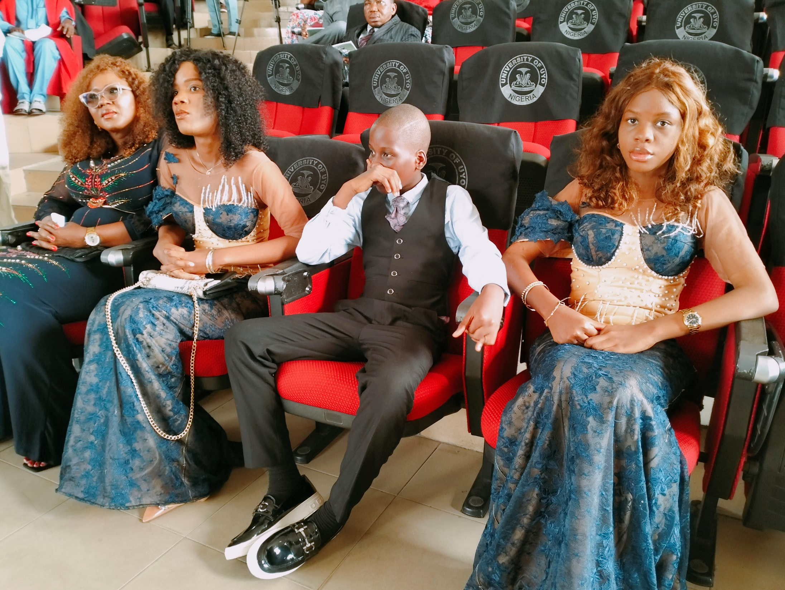

Slide 31
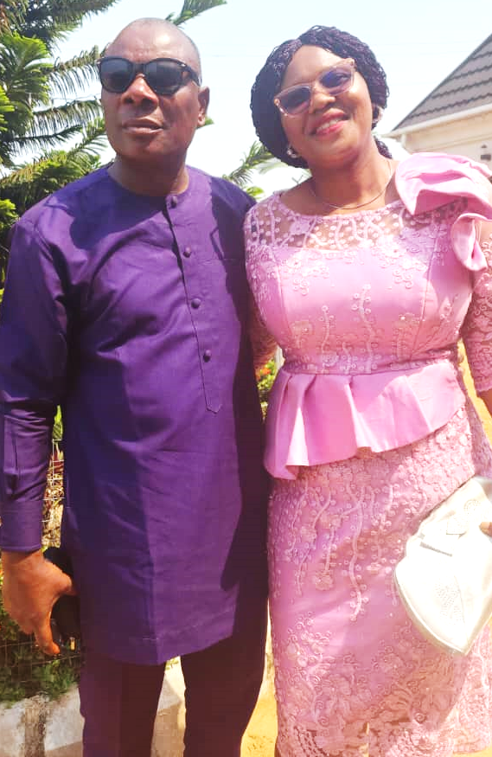

Slide 34
THE REASON FOR THE TITLE OF MY INAUGURAL LECTURE:
The title, ‘Nigeria, a sanely insane society. Who is not insane?’, is a tragic comedy of the people in a country with abundant human and natural resources, who have been and are still groping in darkness and walloping in abject poverty.
Rather than looking into ourselves, all we do, is to lament and blame the country, a mere geographical space, for our predicaments.
We have never sat down to examine ourselves and see how our behaviours have helped in aiding and abetting the mess we have brought to ourselves and the country, including the epidemic and reckless looting of public funds that would have been used to make life better for all.

Slide 35
THE REASON FOR THE TITLE OF MY INAUGURAL LECTURE, contd.:
Indeed, we are the pests that have ruined and destroyed the country and ourselves.
Most of our problems are character-deficit issues and self-inflicted.
Surprisingly, it is the Nigerians who are responsible for these problems that are often honored and rewarded with appointments, promotions, titles and sometimes, honorary degrees from institutions of higher learning.

Slide 36
Nigeria, a sanely insane society. Who is not insane?

Slide 37
INTRODUCTION
Nigeria is already on the edge of a precipice of a failed nation.
Regrettably, most of us do not know that we are the cause of the country’s political, economic and social problems.
Despite over 50 years’ history of oil exploration and exportation, we are still not able to harness our resources and lift ourselves out of misery.
This is sad. The only reason we are unable to meet the expectations and realities of humanity is because of our insane behaviours.

Slide 38
INTRODUCTION, contd.
Our attitude and conduct are weird, and can only be explicable within realm of insanity.
We are all suffering, because we cannot murder sleep and deserve to dream.
Nigeria is still a beautiful country, blessed with abundant natural and human resources.
Therefore, it would be unkind and contemptuous for any of us to denigrate and blame the country for our woes.

Slide 39
INTRODUCTION, contd.
However, the country has been taken hostage, and most of the laudable initiatives or projects that would have put paid to the sufferings of the citizens have either failed or abandoned as a result of greed and corruption. We are all guilty and culpable.
The reward is the widespread poverty, hunger and insecurity.
These are made worse by the weak, archaic, dysfunctional and retrogressive economic policies and implementation.

Slide 40
Nigeria, a sanely insane society. Who is not insane?

Slide 41
The insanity in us
There is no doubt that our behaviours have portrayed us as insane.
Insanity is synonymous with abnormal behaviours, and no one is immune.
A British writer and a politician, Thomas Macaulay (1800-1859) once said and I quote,
‘’the measure of a man’s character is what he would do, if he knew he would never be found out’’.

Slide 42
The insanity in us, contd.
The question is, what we all do in our own little or private corners, do they characterize us as sane people?
In what way have they helped to make our country better?
We parade and subscribe to behaviours devoid of integrity, values and moral standards without knowing we are insane.
We are the problems to ourselves.

Slide 43
The insanity in us, contd.
Sometimes, we are quick to condemn armed robbers, bandits or kidnappers, but some of us engage in behaviours that characterize insanity and are more heinous than these crimes.
The demand for bribe, adultery, prostitution, forgery, lying, sex for appointments, promotions or marks, are all insanity behaviours.
They are no lesser crimes than banditry, kidnapping, stealing or armed robbery.
They are not culturally-acceptable behaviours in any society. The primary reward for these behaviours is the same, and that is feeling pleasure.

Slide 44
The insanity in us, contd.
We feel pleasure by showcasing greed and corruption as normal behaviours. We feel pleasure by bragging and displaying ill-gotten wealth as product of our sweats and achievements. These are nothing, but insanity.
At times, we swear we do not kill, but the number of lives lost from failed or abandoned contracts or projects, including roads, substandard services or goods, fake or expired drugs, are more than the ones lost from armed robbery, kidnapping or banditry.
Mr. Chairman, sir, we all wish we could have a better country. We keep shouting and condemning corruption at every forum in Nigeria, but no one, including even

Slide 45
The insanity in us, contd.
our religious leaders reject the proceeds that come from it.
How many of us live on our legitimate income? Where do we get the extra money from, to augment our ostentatious lifestyle?
Insanity in us is the reason merit and hard work are no more criteria for appointments and promotions in Nigeria.
Insanity in us is the reason titles and honours, even in places of worship are exclusively reserved for men and women of unexplainable sources of wealth or income.

Slide 46
The insanity in us, contd.
Mr. Chairman, sir, Nigeria is ranked among countries with a high corruption perception index (CPI).
This is determined by the levels of public sector corruption as defined by expert assessments and opinion surveys.
Although, the index is ascribed to countries, but it is the human beings that abuse the entrusted power for their personal and private gains.
Therefore, it is always wrong to project any country as being corrupt.

Slide 47
The insanity in us, contd.
Nigeria is not corrupt, but the citizens are. Maybe it is now time to rephrase this concept as the ‘corruption perception index of the citizens’.
Greed and corruption are the reasons Nigeria has not been witnessing growth and development.
We budget and earmark so much yearly for basic necessities of life, yet our roads are dead-trapped, no electricity, medical equipment or essential drugs in our clinics and hospitals, majority of Universities in Nigeria cannot be rated, compared and ranked among the best in the world. We are all clad in greed and corruption.
There is no establishment or organization in Nigeria that is free from corruption. Most government institutions engage in functions outside their statutory mandate.

Slide 48
The insanity in us, contd.
More than 90% of the revenue-generating agencies in Nigeria are corrupt. About 99.9% of monies generated from these agencies go into the private pockets.
The signs of insanity are all over our lives. Therefore, it does not require an expert to profile us. The insanity in us manifest in various ways, and we expect Nigeria to be a paradise on earth. This would never happen.
We are the architects of our doom and suffering. How could we not suffer in a country, where the citizens are the ones collecting all the contracts meant for the development and growth of the country through dubious means, inflate the cost, receive the money and run away without executing the jobs.

Slide 49
The insanity in us, contd.
The corruption in Nigeria is so endemic and pervasive that even our educational institutions, which are supposed to be the bed rock for character moulding and modelling have been rendered useless. Parents are even the ones bribing for their children’s admissions, promotions, results, and certificates.
Despite the increasing cases of fake and forged certificates being brandied by ‘out-of-school men and women’, no school authority in Nigeria has ever been bold or willing to come out and denounce these evil men and women.
No court either, has ever sentenced or jailed any of the culprits, for purposes of sanitizing the system.

Slide 50
The insanity in us, contd.
Whereas, these are things every institution in civilized societies would do to protect its image and reputation. Insanity in us is the reason crimes are rampant in Nigeria.
Mr. Chairman, sir, do you know that most of the monies looted or stolen by Nigerians and others in this country are through the banks? Do you also know that some of these stolen monies are kept in the banks?
Who are the people working in these banks? Nigerians! Who are those that help the looters to launder the stolen money? Nigerians!

Slide 51
The insanity in us.
We have agencies and institutions established purposely to fight corruption, but we are having more corruption than ever before. Looters, armed robbers, bandits, kidnappers, rapists, are no more hiding their faces
They are walking freely on our streets looking for more people to devour.
Nigeria is probably the only country in the world, where those who are saddled with the responsibility of fighting corruption are the ones energizing and beautifying the corruption.

Slide 52
BRAIN AND BEHAVIOUR
A lot of people often attribute behaviours, especially, the bad ones to the manipulations of the evil spirits, wicked people or witches and wizard.
Every behaviour is mediated through the brain. The bad ones are due to the inflamed psyche.
Behaviour is made up of two components-overt and covert behaviours. The overt behaviours are observable actions and responses.
According to Kelly and Saklofske (1994), covert behaviours are private and internal responses, including thinking and remembering, which are very important to the psyche (mind).

Slide 53
BRAIN AND BEHAVIOUR CONTD.
The mind plays a major role in controlling our thoughts, feelings, and by extension, our behaviours.
The brain is the most important organ in human being that coordinates and performs specific functions. It is these functions that constitute behaviour.
The observed responses are the outcome of internal actions. The brain stem, cortex, and the limbic system are the areas in the brain mostly involved in the behaviour and other vital functions necessary for life.
Of all the structures, the limbic system is the one specifically involved in the control of behaviours.

Slide 54
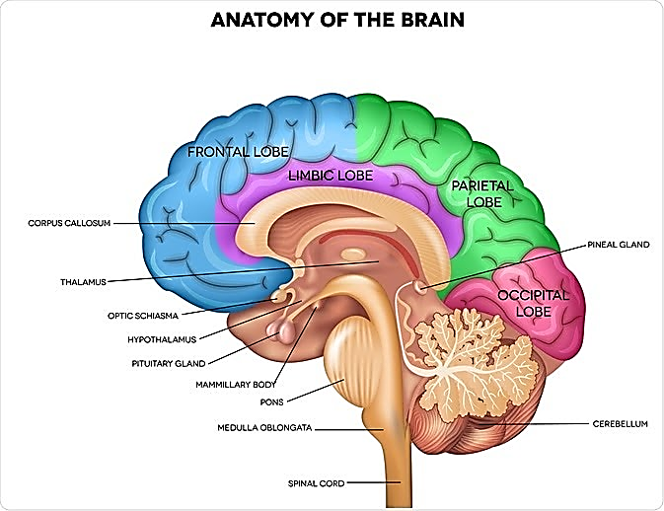
Diagram 1: Brain, The Basis of Behaviour

Slide 55
BRAIN AND BEHAVIOUR CONTD.
The limbic system is known as a reward centre and made up of a number of structures, connected together by two major pathways, the meocortical and mesolimbic pathways arising from the same area in the brain (the ventral tegmental area).
While the mesocortical pathway projects to the prefrontal cortex, the mesolimbic pathway projects to and connects all the limbic structures, including, the amygdala, hippocampus, hypothalamus, nucleus accumbens, thalamus, medial forebrain bundle and parts of the frontal cortex of the cerebrum.

Slide 56
BRAIN AND BEHAVIOUR CONTD.
These structures are responsible for the control of emotion, memory, reward perception and regulate the ability of the individual to feel pleasure.
Feeling pleasure is the primary reward and this motivates one to repeat behaviours time and time again.

Slide 57
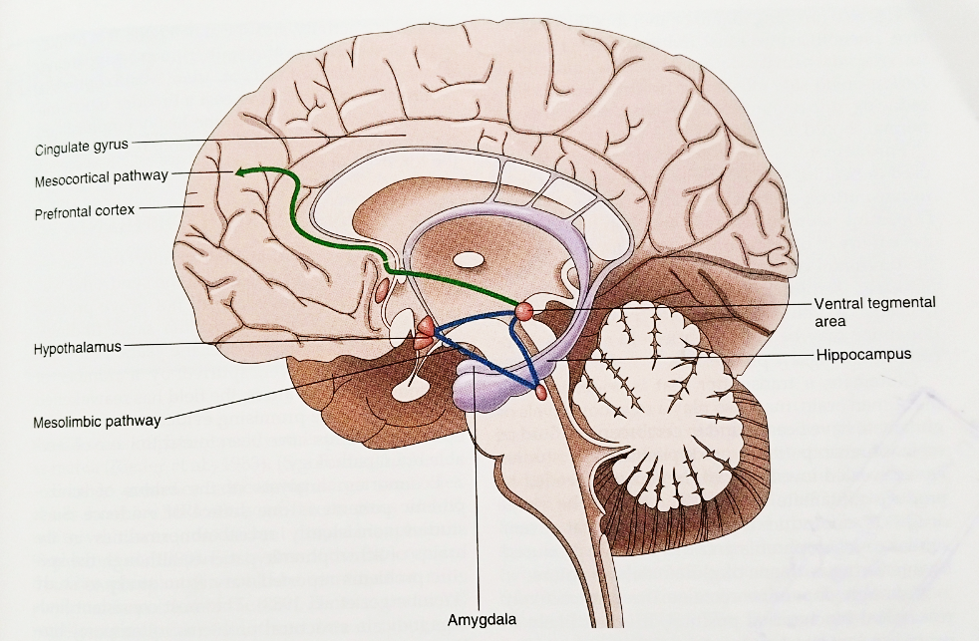
Diagram 2: Limbic system and connections

Slide 58
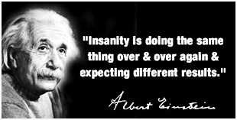
6
What is Insanity?

Slide 59
6. WHAT IS INSANITY, contd.
Truly, this is what insanity is, and it is what characterizes our behaviours in all our dealings and interactions.
But sadly enough, most of us live without knowing that the behaviours we exhibit everyday are what makes us insane.
Insanity does not have a pathognomonic feature, and does not depend on the physical outlook or appearance.
It is defined by the presence of one or more constellation of symptoms of abnormal behaviour, some of which may be present, but none of which is absolutely essential.

Slide 60
6. WHAT IS INSANITY, contd.
Mental health is part of the overall general health, and it is a measure of responses to changes in the mind.
It is these changes that constitute behaviour. The behaviour influences the way we speak, reason, judge, interact with our neighbours, as well as with our environment.
Depending on the context in which the changes occur, a behaviour can be normal or abnormal. A behaviour is abnormal, if it violates or breaks social norms or is contrary to the cultural and societal expectations

Slide 61
6. WHAT IS INSANITY, contd.
The behaviour may be normal, but the context in which it occurs, makes it abnormal.
For instance, a behaviour that would earn a musician billions of Naira can take a University Professor to a mental home.
Nobody would mind or see anything wrong, if a musician sings and dances naked, even in a market square. However, the situation may not be the same, if a University Theatre Arts Professor appears naked, even in his or her personal or private office.
This may not be regarded by all standard as a culturally acceptable behaviour, therefore, the society would frown at it.

Slide 62
6. WHAT IS INSANITY, contd.
It would be a miracle, if the said Professor would not wake up to find himself or herself answering questions in a mental home.
Insanity simply means abnormal behaviours.
The symptoms are the same in all societies, but cultural influence and differences may modify the presentations.
Insanity associated with psychosis is characterized by hallucinations, delusions and illusions in every society, but the contents are influenced by the culture of the people.

Slide 63
6. WHAT IS INSANITY, contd.
What will single out an insane individual first and foremost, are abnormal behaviours.
However, the individual will have delusions of persecution, whether someone comes from America, Russia or Nigeria. But the American may believe the CIA is after him or her, while with the Russian, it is KGB, and in the Nigerian, it is the witches.
All abnormal behaviours are due to the failure of individuals to control emotions and impulses.
Greed, corruption, lies, jealousy, stealing or embezzlement, are definitely symptoms of insanity.

Slide 64
THE COMPASS OF INSANITY (THE BRAIN, BODY, MIND, SOUL, AND THE SPIRIT)
Mental illness has continued to mystify and inspire awe in human beings. This is not unconnected with the myth and superstition surrounding the causes of the illness.
Despite the emerging and increasing evidence that the brain and nervous system are the major organs in the body influencing human thought, feeling and behaviour, a lot of people, including the religious leaders, still belief that mental illness is a spiritual problem.
Many of them mistakenly link mental events with the mind, soul and the spirit. There is no evidence to prove that there is a link. However, this is not unconnected with the miracle of Jesus Christ (Mark 5:8-13).

Slide 65
THE COMPASS OF INSANITY (THE BRAIN, BODY, MIND, SOUL, AND THE SPIRIT)contd.
Christ is reported to have cured a man with an unclean spirit by casting out the devils from within the man and hurling them onto a herd of swine.
The unclean sprit mentioned here is believed or presumed to be mental illness.
The concept of mind, soul and the spirit is complex and beyond human understanding.
The locations, associations and connections of these entities in body are difficult to determine.

Slide 66
THE COMPASS OF INSANITY (THE BRAIN, BODY, MIND, SOUL, AND THE SPIRIT)contd.
They are thought to be the immaterial parts of human beings and are separable from the body.
However, if these are true, does it mean that the drugs used to treat the mentally ill people are anti-spirit or anti-soul or mind?
Christ is also reported to have healed a blind man, by making a spittle mixed with saliva and clay, with which he anointed the eyes of the blind man (John 9:6-7).

Slide 67
THE COMPASS OF INSANITY (THE BRAIN, BODY, MIND, SOUL, AND THE SPIRIT)contd.
Is blindness also a spiritual problem? In the African conception of the person, the body and the mind do not exist separately.
The body is the mind and the mind is the body. We express our feelings and thoughts in relation to the parts of our bodies, whether in health or ill-health.
Medical diseases by nature, are regarded as unfortunate failures of the body outside the person’s control.

Slide 68
THE REAL ISSUES WITH NIGERIANS
Many Nigerians are obsessed with false wisdom and pretend to give the people a sense of leadership and ownership, while in actual fact, do very little to reinforce the convictions of its beneficiaries to the existential realities.
The country has been overtaken by lies and falsehood. Nigerians tolerate and encourage undemocratic principles and accord the dishonest men and women with criminal tendencies who pose as political leaders, the opportunity to become the face of the nation.

Slide 69
THE REAL ISSUES WITH NIGERIANScontd.
Sycophancy has become the only viable means for survival. Nigerians tend to condone wilfully year in year out, the rulership-cultural model that has no regard and respect for human life and dignity.
Those who are supposed to be speaking and condemning the act of rascality are the ones singing the loudest praises for economic saboteurs and looters.
The masses on the other hand tend to forget that suffering is a common denominator. It does know tribe, religion or boundary.

Slide 70
THE REAL ISSUES WITH NIGERIANScontd.
It leaves nobody with a chance of breaking away from the vicious cycle of poverty.
The same masses also are the ones going round cheering and praising those who by their conduct, should be competing for space in prisons with armed bandits, kidnappers, robbers and rapists. Nigeria, a sanely insane society.
Who is not insane?

Slide 71
THE REAL ISSUES WITH NIGERIANScontd.
As a people, we need to discard false and pretentious lifestyle.
We need to sit and ponder on the best way to refine governance system to purge the leadership space of characters, who wear autocratic skin under democratic mask.
It is time we adopt a system that would guarantee a genuine process of sifting-out true and patriotic men and women that would meet the wishes and aspirations of all citizens to occupy political space.

Slide 72
THE REAL ISSUES WITH NIGERIANScontd.
We need to resist the temptation of being coaxed to believe that it is our religion or our tribes that are selectively targeted when people of questionable characters from our domains are fingered out for crimes against humanity.
For so long, Nigerians have been brainwashed to believe hook, line, and sinker that the failure of the country to grow and develop like other civilized nations of the world, is because of the differences in our religion, tribe, or lack of resource control, true federalism, or State police.

Slide 73
THE REAL ISSUES WITH NIGERIANScontd.
No, the problem lies in the Nigerians’ weak egos that accommodate and allow mostly irresponsible and unpatriotic elements with persistent greed and unquenchable lust for wealth as people with the magic wand.
Afterall, why are we not living in peace and harmony with our brothers and sisters in our families, villages, local governments and States, where ethnicity, religion, state police or resource control are not the issues? Indeed, our problems are our behaviours.

Slide 74
THE REAL ISSUES WITH NIGERIANScontd.
Therefore, what we need to do, if we are serious in making Nigeria a better country, is to first of all, restructure our minds.
Without this, even if all the country’s resources are put under one family, there will still be issues bordering on resource control, royal families, marginalization, deprivation and minorities.
For some of us who are from Niger Delta region of Nigeria, how has the 13% oil derivation impacted on our lives?

Slide 75
WHO IS NOT INSANE?
The boundary between mental health and mental illness is very blurred or non-existent.
The mistake most people do, including the highly educated ones is to assume that mental illness is limited to only a few unfortunate individuals, who roam the streets with tattered clothing or sometimes naked, sleeping under the bridges.
No, this is not true. This group of individuals constitutes only about 1-1.5% of all the people with insanity.

Slide 76
WHO IS NOT INSANE?CONTD.
The implication is that 99% of us or more have serious mental issues, but are in our comfort zones, including homes, offices, schools, markets, Churches, etc. we should know that insanity is about abnormal behaviours.
Majority of us engage in sharp and unethical practices, which are abnormal behaviours and by extension, insanity. No one is immune.
The assumption that one is not mentally sick is only a delusion. What determines whether one is insane or not is not where one stays, lives, eats or what one wears, but the behaviour.

Slide 77
WHO IS NOT INSANE?CONTD.
The gradation of mental state from a healthy state to ill-health has shown that no one is really normal.
Nature seems to have divided human population into two groups, the non-iatropic and the iatropic groups.
The demarcation or grouping together is in accordance with how people behave and respond to their daily needs, actions and activities.
The non-iatropic consists of persons with mental illness, but may not have or have mild symptoms. These are the people in the society that would always behave as if nothing is wrong with them, and would never seek help.

Slide 78
WHO IS NOT INSANE?CONTD.
The efficacy of their performance may or may not be lowered, but they may be experiencing one or more distressing symptoms of mental illness from to time to time, without others knowing.
And even if their performance is lowered, the difference may not be glaring. Majority of Nigerians are within the non-iatrophic group of persons with asymptomatic or mild symptoms of mental illness.
Their ability to cope with daily demands is not because they do not have mental illness. The other half of the population represents persons in the community with disruptive distressing symptoms, some may be ambulatory, while others will require hospitalization.

Slide 79
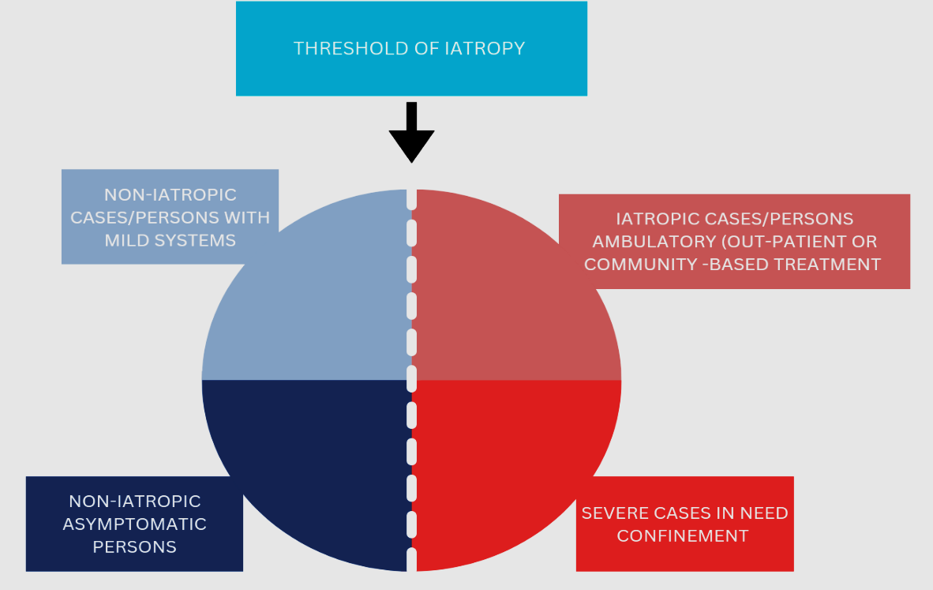
Diagram 3: The continuum from health to ill-health

Slide 80
WHO IS NOT INSANE?CONTD.
Mr. Chairman Sir, mental health is a measure of responses to changes in the mind. There is no other way to know, if one is insane or not, except through one’s behaviour.
We are partakers of abnormal behaviours. We consciously or unconsciously mortgage our conscience, distort and compromise values, standards, and ideals.
Our emotions, thoughts, judgements, reasoning, actions, interactions with our neighbours or environment can go contrary to the cultural or societal expectations.

Slide 81
WHO IS NOT INSANE?CONTD.
Therefore, the conversation should not be on whether one is insane or not, rather it should be on the nature and degree of insanity we all have.
The urge that makes someone to walk naked on the street and the urge that makes another person to steal or do any other abnormal thing, is the same.
Walking naked, stealing or doing any thing abnormally is the same, because feeling pleasure is the primary reward.

Slide 82
WHO IS NOT INSANE?CONTD.
There is no difference between someone who eats from the refuse dumps and a school teacher or lecturer, who demands money or sex, before he or she could pass his or her student in an examination or a colleague in office, who works so hard to deprive his or her own fellow colleague, comfort and happiness or a chief executive, who demands gratifications before rendering help or a student, who cheats in an examination.
The urge is the same in any man or woman, who manipulates or circumvents the system, for his or her personal gain or uses his or her position, connections, affiliations, associations, or relationships, to cheat, steal, kill or bring sorrow and agony to his or her fellow human being.

Slide 83
WHO IS NOT INSANE?CONTD.
What makes the behaviour to occur and to be repeated time and again, is the primary reward.
There is no corner in our life that is devoid of abnormal behaviours. Even in our homes, we find it difficult to comply with laid down rules.
In our work places, how many of us would go to our offices on time and stay till it is time to close? What about using government hours for our private businesses?
How can we say we are mentally sound when we indulge in all these behaviours?

Slide 84
WHO IS NOT INSANE?CONTD.
We pray every day before we leave our homes, and every morning in our offices, before we resume work, but in that same offices, we hide files, collect bribes, pilfer, backbite, hold grudges, fight, render insults and abuses on others. Most of us go to our offices late, but how many of us write the exact time we actually resume work in our offices?
These are all abnormal behaviours and by extension, insanity.
Mr. Chairman, sir, Nigeria has been and is still struggling, because we are always thinking of an easy, but not the right way of doing things. We prime ourselves for success without work. We represent the real, rather than the ideal, and thrive for pleasure rather than perfection.

Slide 85
WHO IS NOT INSANE?CONTD.
Mr. Chairman, sir, I am very sorry, if by talking the way I do I am making all of us uncomfortable.
This is what it is, the truth and nothing, but the truth. It is not possible for one to claim that he or she is mentally sound.
The stress-diathesis-model, which uses the integration of biological, psychosocial and environmental factors to explain the possibility of one having mental illness, applies to all of us.
We all have specific vulnerability that when acted on by some stressful environmental influences or life events, allow the development of symptoms of mental illness.

Slide 86
WHO IS NOT INSANE?CONTD.
Life itself is a challenge, and sometimes with unpredictable and unfavourable outcomes.
A clean or holy appearance or look does not confer one with the ability or power to avoid emotions.
Stress, emotional burnout, sleeplessness, racing thoughts, anxiety, unexplained sadness or expansive mood or excessive or uncontrollable happiness, are all symptoms of mental illness. Nigeria, a sanely insane society. Who is not insane?

Slide 87
WHY INSANITY BEHAVIOURS ARE RAMPANT AMONG NIGERIANS
Abnormal behaviours seem to be rampant in Nigeria because many Nigerians appear to be mentally unstable.
The behaviours characterize the way the minds work. Many are labouring under the disease of mind.
Insanity distorts the minds and deprive individuals of the ability to control their thoughts, speeches, reasoning, judgments, relationships with one another and the environment.
Majority of Nigerians have personality problems, and because the symptoms are alloplastic, that is capable of adapting and altering the external environment, they do not usually know or believe that they are mentally sick.

Slide 88
WHY INSANITY BEHAVIOURS ARE RAMPANT AMONG NIGERIANS, contd.
And because these symptoms are also ego-syntonic, that is acceptable to the ego, they are always impervious to treatment.
As a result, they go about behaving irresponsibly and exhibiting antisocial behaviours, by working only inconsistently and being reckless, breaking laws, defaulting on agreements, irritable and physically aggressive.
Relationships, the matrix within which people live their lives and are the sources of obligation, responsibility and friction, are often neglected or disrupted.
Those with neurotic conditions are perpetually under severe stress and anxiety, with far-reaching consequences on the day-to-day actions and activities.

Slide 89
WHY INSANITY BEHAVIOURS ARE RAMPANT AMONG NIGERIANS, contd.
Others with psychotic conditions are deluded and act or behave in response to hallucinatory voices or delusions.
Many others with mood disorders are either manic or depressed, with low self-esteem, self-confidence and poor work performance and some may suffer from psychological complications associated with other medical conditions or drug use and abuse.
All these may have accounted for the increasing incidence of crimes, corruption, misgovernance and misrule in Nigeria.

Slide 90
IMPACT OF INSANITY BEHAVIOURS ON THE NIGERIAN STATE
There is a link between our behaviours and all the problems confronting the nation. Insanity behaviours occur as a result of not knowing or doing what is right.
Mr. Chairman, Sir, poverty, hunger, unemployment and insecurity are the creation of the society. The entire country is experiencing increasing loss of hope, erosion of good quality of life, poverty, hunger, unemployment, insecurity and poor governance.
Access to food, water, education and healthcare continue to remain elusive.

Slide 91
Nigeria is experiencing infrastructural deficits, and abandoned projects are scattered over the country.
Monies meant for the development and provision of basic amenities are siphoned into private pockets.
Most times, expenditure for consultancy services for projects or contracts, are far more than the actual cost of the projects or contracts themselves. Employment in the country is traded like stocks on the floor of the stock exchange.
The advertisements are no longer seen on the pages of Newspapers or heard from the electronic media.

Slide 92
In most cases, they come long after the cronies, friends and relatives or those with connections, affiliations, associations and relationships have already been employed.
The poor continue to bear the brunt, and sometimes in addition, they are scammed or duped and made to pay for non-existing vacancies.

Slide 93
The increasing incidence of cultism, militancy, banditry, kidnapping, armed robberies and even the farmers-herders’ conflicts, are the overwhelming evidence of severe disorderly conduct of Nigerians.
We are all suffering from the impact of insane behaviours. Where else in the world have we heard of snakes swallowing money?
But it has happened in Nigeria. Our behaviours are the reasons money budgeted and allocated to politicians are more than what goes into agriculture, industry, infrastructures, education, health, electricity.
Nigeria, sanely insanely society. Who is not insane?

Slide 94
Will Nigeria ever be better? The answer is no! The dream of having a better Nigeria is still a fantasy. How can we have a better country, when looters and economic saboteurs are the ones populating the political space?
When those responsible for law making would demand for bribe before they could approve or pass budget that is meant to improve the living standards and conditions of the citizens?
When learning and character are no more criteria for awarding certificates and degrees in our educational institutions? How can we have a better country, when our judiciary system is designed deliberately to give mercy to the wrongdoers?

Slide 95
When the police are only interested in providing security and protection to criminals and men and women of questionable means of livelihood?
How can we have a better country, when doctors are no more interested in saving lives, but are competing with armed robbers to rid the clinics and hospital of drugs and equipment?
Mr. chairman, with due respect sir, I am not a prophet of doom, but I think Nigeria will continue to have corrupt-minded people at every helm of affairs, until we are able to subject ourselves to routine and compulsory psychiatric evaluation from time to time.
It is sad to note that despite the increasing number of religious organizations in Nigeria, we are still very far from God and the truth.

Slide 96
In the olden days, men of God, through their works and morality were great instrument for political change and social order.
Today, it is very difficult to find honest men and women. What attracts most people to Churches and other places of worship is prosperity.
There is no more regard for holiness. We are now witnessing the emergence of self-acclaimed religious merchants, who go about patronizing and beautifying political meetings and ceremonies.
No one dares to criticize or condemn the rot in the society, for fear of losing favour or gratifications. Nigeria, a sanely insane society. Who is not insane?

Slide 97
My Personal Contributions
My effort over the years has been focused on having a free, safe and well secured society.
To achieve this, I have been involved deeply in promoting culturally acceptable behaviours, by tackling and managing individuals with mental illness and drug abuse, two most important health-related conditions, identified as being responsible for aiding and abetting the escalation and perpetuation of increasing incidence of social ills in our environment.

Slide 98
My Personal Contributions contd.
By engaging in mending habits and behaviours, I have been able to add meaning and dignity to the lives of the most neglected group of human beings, who by no faults of theirs, have been and are still being subjected to abuses and other forms of inhuman treatment.
I am fulfilled and happy that many of them who had hitherto been written off, have had the chance of being rehabilitated and reintegrated back into the society. There is a positive correlation between mental illness, drug abuse and crimes.

Slide 99
MENTAL ILLNESS AND CRIME
Mental illness is a major contributory factor to criminal activities in our environment.
Crime is a socio-culturally concept with serious consequences to the society.
The relationship between crime and mental illness is influenced by several factors, including the rate of crime, the operation of the criminal justice system, social policy in respect of the offenders and provision of health and social care for mentally troubled persons.

Slide 100
MENTAL ILLNESS AND CRIME CONTD
There has been a growing concern with respect to increasing number of mentally ill people associated with crimes.
Mental illness causes distortion and disorganization in the reasoning process and predisposes the sufferers to various types of criminal acts, including drug use and its associated problems.
The dysfunctional and unorganized lifestyle of the drug predispose them to various crimes.

Slide 101
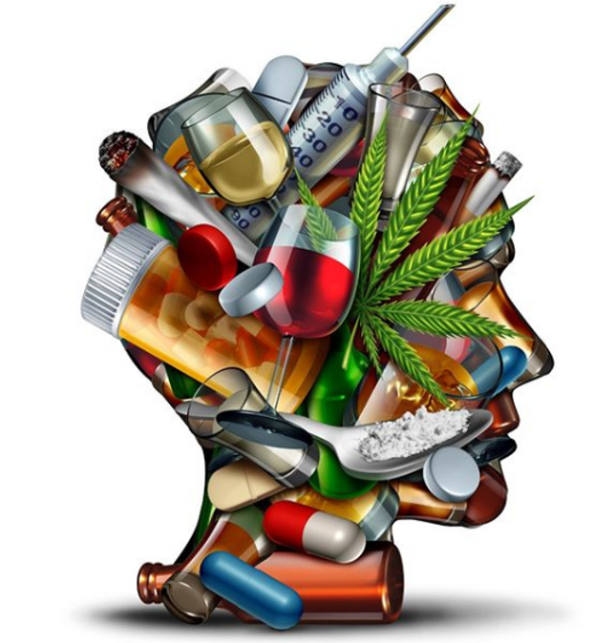
USE OF ALCOHOL AND SUBSTANCES (DRUGS) OF ABUSE
Alcohol/drug abuse is a major social and public health problem all over the world. Nigeria is not isolated and insulated from the menace of drug use or abuse.
The young people are overwhelmingly the majority of victims. The use cuts across all age groups, including even pupils in primary schools. Drug use begins early in life.
The age of onset is getting lower and lower, and more youths are getting involved.

Slide 102
In our environment, the use usually starts in most cases, with the indulgence in local and traditionally available substances, such as kolanuts,
bitter kola, snuff, tobacco, palm wine, in the form of local gin (ogogoro), liquor, and dried plantain leaves, often being used by children in some local communities as cigarettes.

Slide 103
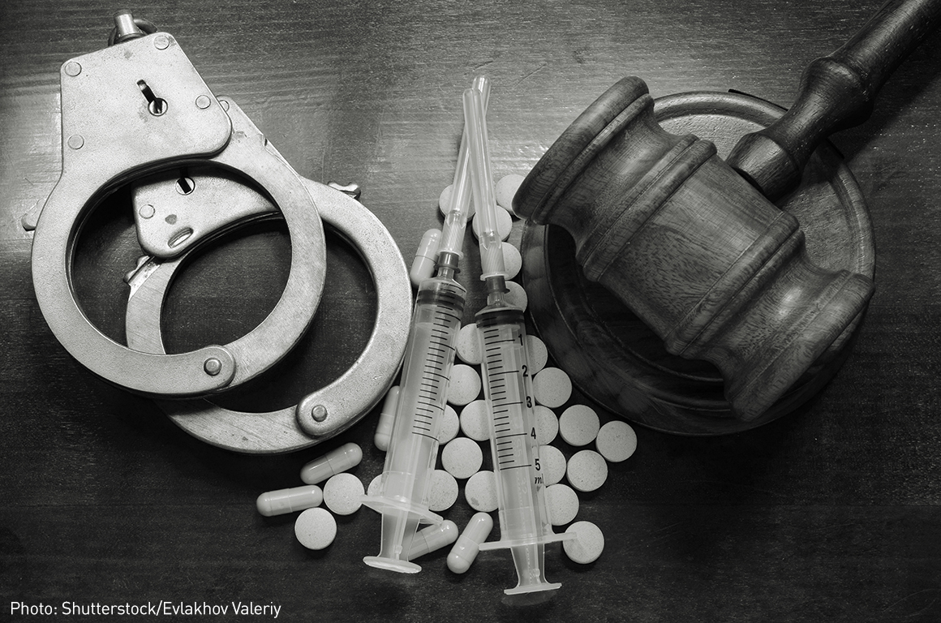
These substances serve as a ‘gate-way’ to the use of more potent or habit-forming substances (drugs), such as cannabis, amphetamine, cocaine and heroin.
In many local settings, the use of local and traditional substances is not restricted and carries no consequence of offence or punishment on anybody, including children.

Slide 104
Drug use is a source of concern in Nigeria. The high incidence of crimes and disruptive behaviours are attributable to the influence of these substances.
The involvement of youths poses a major problem, because they are the building block of any nation and leaders of tomorrow.
Anything that affects them, affects the nation. Let me highlight a few of the studies I embarked on drug use and abuse:

Slide 105
Drug use and general health survey of secondary school students in Akwa Ibom State (Abasiubong et al., 2008)
This was a two-stage study involving 1,331 students from Senior Secondary classes 1 to 3 in three secondary schools in Akwa Ibom State.
The first stage involved screening all the students for the use of alcohol and other substances of abuse. The second stage was to determine the general mental health status of those who were found to have used drugs.
Of the 1,331 students, 639 (48.0%) aged between 14-25 years were males and 692 (52.0%) aged between 11-19 females. The mean age for males was 17.3±2.2 years and that of females was 14.8±1.6 years.

Slide 106
A total of 324 consisting of 253 (39.6%) males and 71(10.3%) females were involved in the use of substances.
The pattern of use showed that 56 (17.6%) students used kolanuts/bitter kola, 76 (23.5%) used tobacco including cigarettes, 144 (44.4%) used alcohol in the form of palmwine, local gin, liquor and hot drinks/beer of all types, 54 (16.7%) used sedatives, 21 (6.5%0 used Indian Hemp and 3 (0.9%) indulged in cocaine.
The reasons for using drugs were many and variable. A total of 83 (32.8%) males were involved in drugs use due to peer group pressure, 57 (22.7%) males used drugs because of availability, 17 (6.7%) to increase performance, 25 (9.9%) to solve personal problems, while 42 (16.6%) had no obvious reason to indulge in drug use.

Slide 107
Of the 253 males that used substances, 69 (27.3%) scored 3 and above the cut-off point on General Health (GHI) instrument, indicating ‘caseness' (mental illness) and 13 (18.3%) out of 71 females scored 3 and above the cut-off point on GHI.
A breakdown of those who scored 3 and above the cut-off point (caseness) revealed 42 (51.2%) met the criteria for neurotic disorders (anxiety and somatization disorders), 31 (37.8%) depression and 9 (11.0%) psychotic disorders.

Slide 108
The high point of this study was that drug use or abuse was common among secondary school students. Female students were also involved.
However, males had 2.98 odd ratio of using drugs. The use was more in disruptive and chaotic family settings. Majority of the students used or abused drugs, because they are readily available.
A few others used them to solve personal problems. The use was positively correlated with gender, family type and upbringing.

Slide 109
Many of the students involved in drug use also showed the possibility of having mental illness, as reflected by the high GHI scores.
Through studies like this, it is possible to identify the target population that needs help.
These are the individuals I have been working on in the society, to promote and improve culturally acceptable behaviours.

Slide 110
The preponderance of crime in Nigeria is attributable majorly to the poor mental states of Nigerians and drug abuse.
Risk-taking behaviours and criminal acts are common among the mentally deranged population.
Therefore, the availability and provision of health and social care for the mentally incapacitated individuals, will go a long way in ensuring a safe and well secured environment.

Slide 111
SUMMARY OF THE FINDINGS:
Table 1: Sociodemographic characteristics of the students
Characteristics Males Females Total
Age in years n (%) n (%) n (%)
Below 15 313 (23.5) 283 (21.3) 596 (44.8)
15-20 209 (15.7) 336 (25.2) 545 (40.9)
21-25 117 (36.1) 73 (22.5) 190 (58.6)
Educational level
SS1 294 (22.1) 301 (22.6) 595 (44.7)
SS2 243 (18.3) 260 (19.5) 503 (37.8)
SS3 102 ((7.6) 131 (9.9) 233 (17.5)

Slide 112
Family Type
Monogamy 345 (25.9) 371 (27.9) 716 (53.8)
Polygamy 212 (15.9) 220 (16.5) 432 (32.4)
Single Parents 82 (6.1) 101 (7.6) 183 (13.7)
Upbringing
Both parents 402 (30.2) 423(31.8) 825 (62.0)
Father only 97 (7.3) 103 (7.7) 200 (15.0)
Mother only 103 (7.7) 147 (11.1) 250 (18.8)
Relation 37 (2.8) 19 (1.4) 56 (4.2)
Orphanage 5 (0.4) 3 (0.2) 8 (0.6)

Slide 113
Table 2: Prevalence and Pattern of Substance use among students
Substance Males Females Total
n (%) n (%) n (%)
Kolanuts/bitter kola 43(13.3) 13 (4.0) 56 (17.3)
Tobacco/cigarettes 69 (21.3) 7 (2.2) 76 (23.5)
Alcohol 117 (36.1) 27 (8.3) 144 (44.4)
Inhalants - - -
Sedatives 16 (5.0) 38 (111.7) 54 (16.7)
Indian hemp 21 (6.5) - 21 (6.5)
Cocaine 3 (0.9) - 3 (0.9)
Heroin - - -
LSD -
LSD=Lysegic diethylamide acid

Slide 114
Table 3: Reasons for using the substances (drugs)
Reasons Males Females
n (%) n (%)
Peer group pressure 83 (32.8) 17 (23.9)
Availability 57 (22.5) 9 (12.7)
Feeling high 29 (11.5) -
Increase performance 17 (6.7) 13 (18.3)
For solving personal problems 25 (9.9) 21 (29.6)
No obvious reason 42 (16.6) 11 (15.5)
Total 253 (100) 71 (100)

Slide 115
Table 4: Logistic Regression of substance use with sociodemographic characteristics of students as independent variables.
Variables Odd Ratio (95% CI) P-value
Age 0.517 (1.023-2.331) 0.234
Sex 3.982 (0.241-0.506) 0.011*
Year of study 0.413 (0.565-1.347) 0.962
Family Type 0.505 (0.549-1.33) 0.001*
Upbringing 2.417 (0.117-0.394) 0.025*
*statistical significant

Slide 116
I also investigated the commercial motorcycle operators in Akwa Ibom State, for use of alcohol and other substances of abuse.
This was to increase awareness for purposes of reducing the high incidence of morbidity and mortality often associated with commercial motorcycling.
The commercial motorcycling business has come to stay in Nigeria for several reasons, including, the poor state of Nigerian roads, poverty and unemployment.

Slide 117
The trade is very popular and widely patronized in all nooks and crannies in Nigeria, including the urban cities.
Being an all-comer affair, one does not need to undergo any apprenticeship or have certain educational qualifications, before joining the trade.
The non-regulation of the business seems to attract more people and competition for passengers. In order to stay long hours for more proceeds, a lot the operators take to using drugs, thereby exposing them and general public to hazard, and sometimes leading to loss of life.

Slide 118
Alcohol /Psychoactive Substance Use and influence among commercial Motorcycle Operators in Uyo, Akwa Ibom State, Nigeria (Abasiubong, et al., 2007).
Two thousand, two hundred and eight Commercial Motorcycle Operators were randomly recruited and screened for the use of alcohol and other substances of abuse using a modified form of the World Health Organization (WHO) guidelines for substance use survey.
Majority of the operators were below 50 years of age. The mean age was 31.7 ± 3.1 years. A total of 1,779 (80.6) operators used more than one substance and only 429 (19.4) were non-users.

Slide 119
Further breakdown of the results showed variable patterns and prevalence of use of these substances; 342 (19.2%) used both kolanuts and bitter kola, 257 (14.4%) used coffee, 316 (17.8%) snuff/tobacco and cigarettes, 482 (27.1%) used alcohol in the form of palm wine, local gin beer, liquor, etc.
A total of 382 (21.5%) used more potent or habit-forming substances,309 (17.4%) used Indian Hemp, 51 (2.9%) used Cocaine and 22 (1.2%) used Opiates including Heroin, Cough syrup and Tramadol. Majority, 1097 (49. 7%) of the Operators had no other job than commercial motorcycling, 333 (15.1%) combined the business with the farming, 461 (20.9%) with trading, while 409 (18.5%) Operators were civil or public servants.

Slide 120
The Operators also volunteered various reasons for indulging in substances. Majority, 520 (29.2%) used substances to stay long hours on the road for more returns (increased performance), 311 (17.5%) used substances because of the availability, 236 (13.3%) because of un/underemployment, 246 (13.8%) peer pressure, 268 (15.1%) to feel high, 93 (5.2%) out of curiosity, while 105 (5.9%) had no obvious reason to use substances.
It was discovered that traffic offences and accidents were common among those using either alcohol, cannabis or both.
Many of them had no knowledge of the harmful effects of these substances.
Therefore, greater attention must be focused on this group of individuals to increase awareness so as to rid the society of the menace associated with drug use or abuse.

Slide 121
SUMMARY OF THE FINDINGS:
Table 5: Sociodemographic characteristics of the Commercial motorcycle operators
Variables Number Percentage
Age (years):
≤20 71 3.2
20-29 1282 58.1
30-39 497 22.5
40-49 315 14.3
≥50 43 1.9
Educational level:
No formal education 169 7.7
Primary school 639 28.9
Secondary school 1137 51.5
Post-Secondary school 263 11.9

Slide 122
Marital Status:
Never married 831 37.6
Married 1007 45.6
Separated 250 11.3
Divorced 53 2.4
Widower 67 3.1
Occupation:
No other work 1097 49.7
With some farming 333 15.1
With some trading 461 20.9
With Civil/Pub. Service 409 18.5

Slide 123
Table 6: Prevalence and use of alcohol/substances among the Commercial motorcycle operators
Substances users Non-Users
n (%) (%)
More than one substance 1779 (80.6) 429 (19.4)
Kolanuts//Bitter kola only 342 (19.2) 1437 (80.8)
Coffee 257 (14.4) 1522 (85.6)
Snuff/Tobacco/cigarettes 316 (17.8) 1463 (82.2)
Alcohol (Palm wine, beer, gin) 482 (27.1) 1297(72.9)
Indian Hemp 309 (7.4) 1470 (82.6)
Cocaine 51 (2.9) 1728 (97.1)
Heroin 22 (1.2) 1757 (98.8)
Lysergic diethylamide acid (LSD) - 2208 (100.0)
Anabolic steroids - 2208 (100.0)

Slide 124
Table 7: Reasons for using alcohol/substances by the Commercial motorcycle operators
Reasons Number of Subjects Percentage
Peer pressure 246 13.8
Feeling High 268 15.1
Availability 311 17.5
Curiosity/experimentation 93 5.2
Increased performance 520 29.2
Un/under employment 236 13.3
No reason 105 5.9

Slide 125
In 2014, I was invited by the Kano State government to take part in the drug rehabilitation programme of the youths who were found to be abusing substances.
During the period, I designed and conducted a study to compare the prevalence and pattern of use of substances of abuse in two Nigerian cities, one in the North and the other one in the South.
This was to determine the influence of culture and religion in the use of these substances.

Slide 126
Comparative Study of Pattern of use of Alcohol/Substances among inmates in two Nigerian cities located in the Northern and Southern Nigeria (Abasiubong et al., 2014)
Two groups of inmates from different culture, totalling 338 and consisting of 190 (56.2%) from Uyo, Akwa Ibom and 148 (43.8%) from Kiru in Kano State, were recruited into the study.
Data from 320 (94.7%) inmates, consisting of 179 (55.9%) from Uyo and 141 (44.1%) from Kiru were analysed. A total of 18 (5.3%), comprising 11 (3.2%) from Uyo, and 7 (2.1%) from Kiru were discarded due to incomplete information.
The mean age of the inmates from Uyo was 26.3± 2.7 years compared to 23.7± 3.9 years from Kiru. More inmates 83 (24.5%) from Uyo compared to 33 (9.8%) from Kiru had secondary school education and above.
The lifetime prevalence use of alcohol was higher, 47.4% in Uyo compared to 21.3% in Kiru. Current use prevalence of more than one substance was higher, 54.6% in Kiru as against 45.2% in Uyo.

Slide 127
The use of alcohol in any form was much higher in Uyo compared to Kiru. Cough syrup and sleeping drugs were used in both cities, but more Kiru.
Unlike in Uyo, inhalants in the form of shoe polish, tan, petrol, super glue, formalin and fumes from soakaway were commonly used in Kiru.
The use of Cigarette and Cannabis was high in both cities. Reasons for use of these substances in both cities were similar. Locality, availability and religion influenced the type of substances used.
The high point of this study was that the use of substances cut across all boundaries in Nigeria, and youths are heavily involved. There is need to scale-up community-based strategies for effective control of use of these substances.

Slide 128
Table 8: Comparison of pattern and prevalence of substance use among the inmates
Substances Inmates
Uyo Kiru
n (%) n (%) X² P-value
More than one substance 81 (45.2) 77 54.6) 0.95 0.340
Kolanuts/Bitter kola 34 (19.0) 91 (64.5) 8.17 0.001*
Snuff/Tobacco/Cigarette 41 (22.9 93 (66.0) 3.88 0.001*
Alc (Palm wine, beer, etc.) 66 (51.9) 5 (3.5) 7.00 0.001*
Sleeping drugs 23 (12.8) 49 (34.7) 4.53 0.001*

Slide 129
Cough syrup 23 (12.8) 67 (47.5) 6.73 0.001*
Inhalants (Petrol, glue, s/polish) 5 (2.8) 29 (20.6) 4.94 0.001*
Indian Hemp 63 (35.2) 61 (43.3) 1.36 0.174
Cocaine 13 (7.3) 21 (14.8) 1.98 0.048*
Heroin 9 (5.0) 17 (12.0) 2.07 0.038*
Benhexol (Artane) - 19 (13.5) - -
Anabolic steroid 7 (3.9) - - -
*Statistical significant
Alc (alcohol)
s/polish (shoe polish)

Slide 130
Table 9: Reasons for using substances by the Inmates
Variables Inmates
Uyo Kiru n (%) n (%)
Availability (easy to get) 45 (25.1) 37 (26.7)
Influence from others (peer group pressure) 43 (24.0) 35 (24.8)
Feeling high 33 (18.4) 29 (20.6)
Increased performance 8 (4.5) 18 (10.0)
Unexplained personal Problems 21 (11.7) 9 (6.4)
Social pathologies (Un/underemployment) 33 (18.4) 21 (14.9)

Slide 131
S
For Nigeria to be a better country, the citizens must have to be mentally sound. Therefore, there is need for every Nigerians to undergo from time to time routine and compulsory psychiatric evaluation, to ascertain their mental capacity, uprightness and correctness.
Nigerians earnestly need to restructure their minds by cultivating culturally acceptable behaviours devoid of ethnicity, religion, suspicion, and hatred.
Nigeria as a country cannot grow and develop, unless certain items in the Constitution are revisited. Items such as ‘Federal Character’ and ‘State of Origin’, must be expunged from the Nigerian Constitution. These two items are inimical to competition, growth and development.

Slide 132
S
Nigerians must pay greater attention to character moulding and modelling. Consideration and recognition for awards, titles, and honours, should not be based on social status or wealth, but integrity, good character, and meaningful contribution to the society.
The government must be serious in reforming and sanitizing the system by formulating workable policies that would ensure that criminals and economic saboteurs are dealt with, in accordance with the laws of the land, and not based on religion, ethnicity or technicalities.

Slide 133
S
Finally, I recommend that Nigeria as a country, must encourage positive socio-cultural attributes.
The citizens must be ready to embrace reforms and policies that would put the country among the developed and civilized nations. The issue of monthly salaries/wages should be interrogated.
It is high time, Nigerians stopped deceiving themselves. A lot of Nigerians receive or earn salaries for doing nothing. Evidence has shown that there is high efficiency and productivity in countries, where workers are paid according to the number of hours they put into their jobs.

Slide 134
“Never be afraid to raise your voice for honesty, truth and compassion against injustice, lying and greed. If people all over the world would do this, it would change the earth”.
William Faulker

Slide 135
The major aim of this lecture was to convey some of the intellectual excitements that are associated with the search for solutions to some of our teething problems.
I am convinced that through this lecture I have succeeded in unveiling fairly and comprehensively the glimpses of how all of us have helped in bringing Nigeria, our dear country, to its knees.
We could not have had a better country. It is morally reprehensible to blame the country for our woes.

Slide 136
The hope is not lost and the dream of a better country is still realizable, but we must all be ready to serve as a moral compass.
It would be impossible to solve our problems, without first of all, looking into ourselves.
It is not only the prayers of the righteous that would make the light to shine and dispel the darkness over Nigeria, but the collective efforts and will to speak the truth and do the right thing at all times.
May God grant us people, who are ready for service unto humanity and not unto their pockets, Amen!

Slide 137
Let me use this opportunity to thank all the people that have come to grace this occasion.
Today, you have made me bigger and taller than my size and height.
I am grateful, and for coming here to honour and celebrate with me, celebration will never cease in your homes.
May God grant all of you journey mercies back to your various destinations, Amen!

Slide 138
THIS LECTURE IS
DEDICATED TO
DR. IVY NNEKA UMANAH

Slide 141
PROFESSOR FESTUS UDO BASSEY ABASIUBONG
Professor of Consultation-Liaison Psychiatry
College of Health Sciences, University of Uyo, Uyo.

Slide 142
Chairperson’s Brief Comments…
INAUGURAL LECTURE
OF THE UNIVERSITY OF UYO
Professor Nyaudoh Ndaeyo
Vice-Chancellor, University of Uyo, Uyo

Slide 143
PROFESSOR FESTUS UDO BASSEY ABASIUBONG
Professor of Consultation-Liaison Psychiatry
College of Health Sciences, University of Uyo, Uyo.

Slide 146
Recognitions

Slide 147
INAUGURAL LECTURE
OF THE UNIVERSITY OF UYO
Was lectured by
PROFESSOR FESTUS UDO BASSEY ABASIUBONG
Professor of Consultation-Liaison Psychiatry
College of Health Sciences,
University of Uyo, Uyo.
Topic:
NIGERIA, A SANELY INSANE SOCIETY. WHO IS NOT INSANE?
THURSDAY, OCTOBER 26, 2023.

Slide 149
UNIUYO ANTHEM
Let us all rise as one and light up
Wisdom’s pa-th, the citadel
Our great forebears raised
From nur-sery to its apogee
Now stands like a giant
In the African Sun
Arise, Arise, G-r-e-a-t UNIUYO
We shall arise and
Shine and take our place
In the fir-ma-ment
Of cultured men; And women Blest
With wisdom’s depth of vision
And leave behind
Traditions for generations to come
Arise, Arise, G r e a t Uniuyo
Arise, Arise, Arise, and shine forth...
G-r-e-a-t UNIUYO

Slide 151
NATIONAL ANTHEM

Slide 152
Closing Prayers

